Slide 1


Slide 2
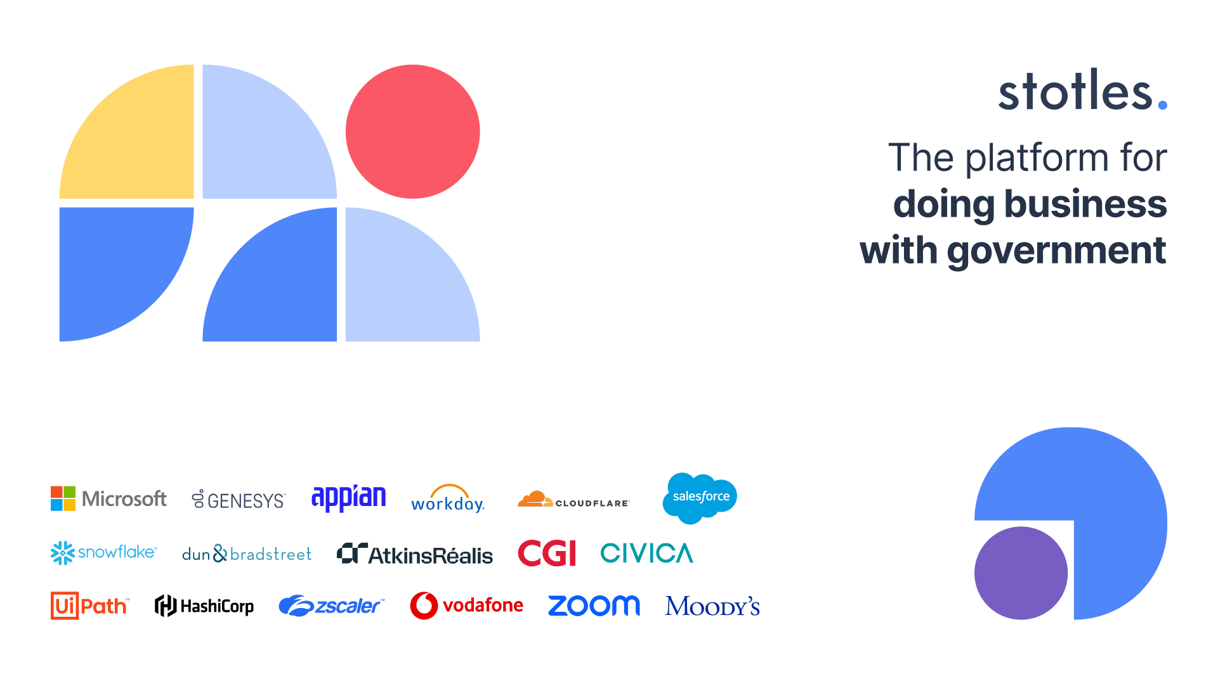

Slide 3
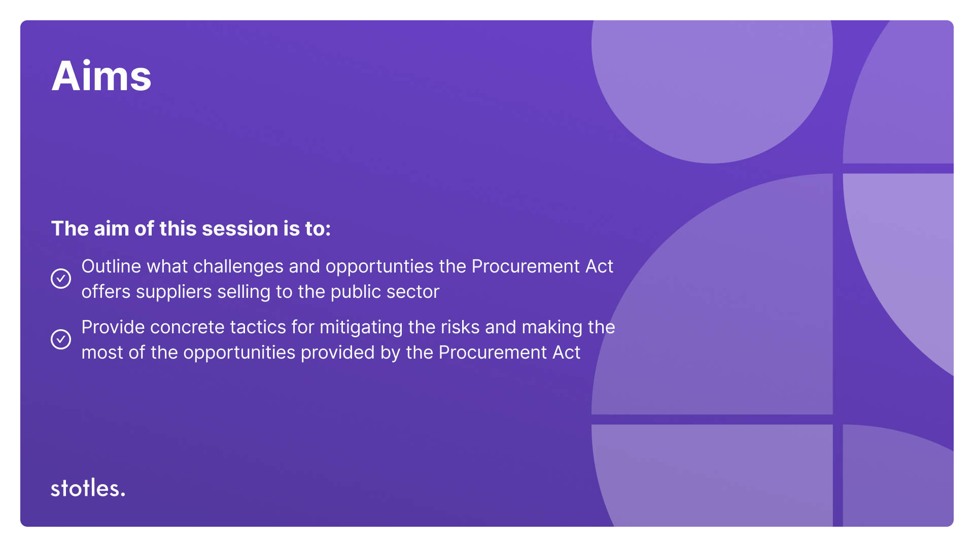
Notes:
This is a not a webinar about policy and the specific changes the Act will bring about
I’m sure you’ve been inundated with content about the changes in policy
This is practical advice in the specific context of creating public sector pipeline and successfully selling into the public sector
The aim of this webinar is to:
Outline what challenges and opportunties the Procurement Act offers suppliers selling to the public sector
Provide concrete tactics for mitigating the risks and making the most of the opportunities provided by the Procurement Act so you can build pipeline

Slide 4
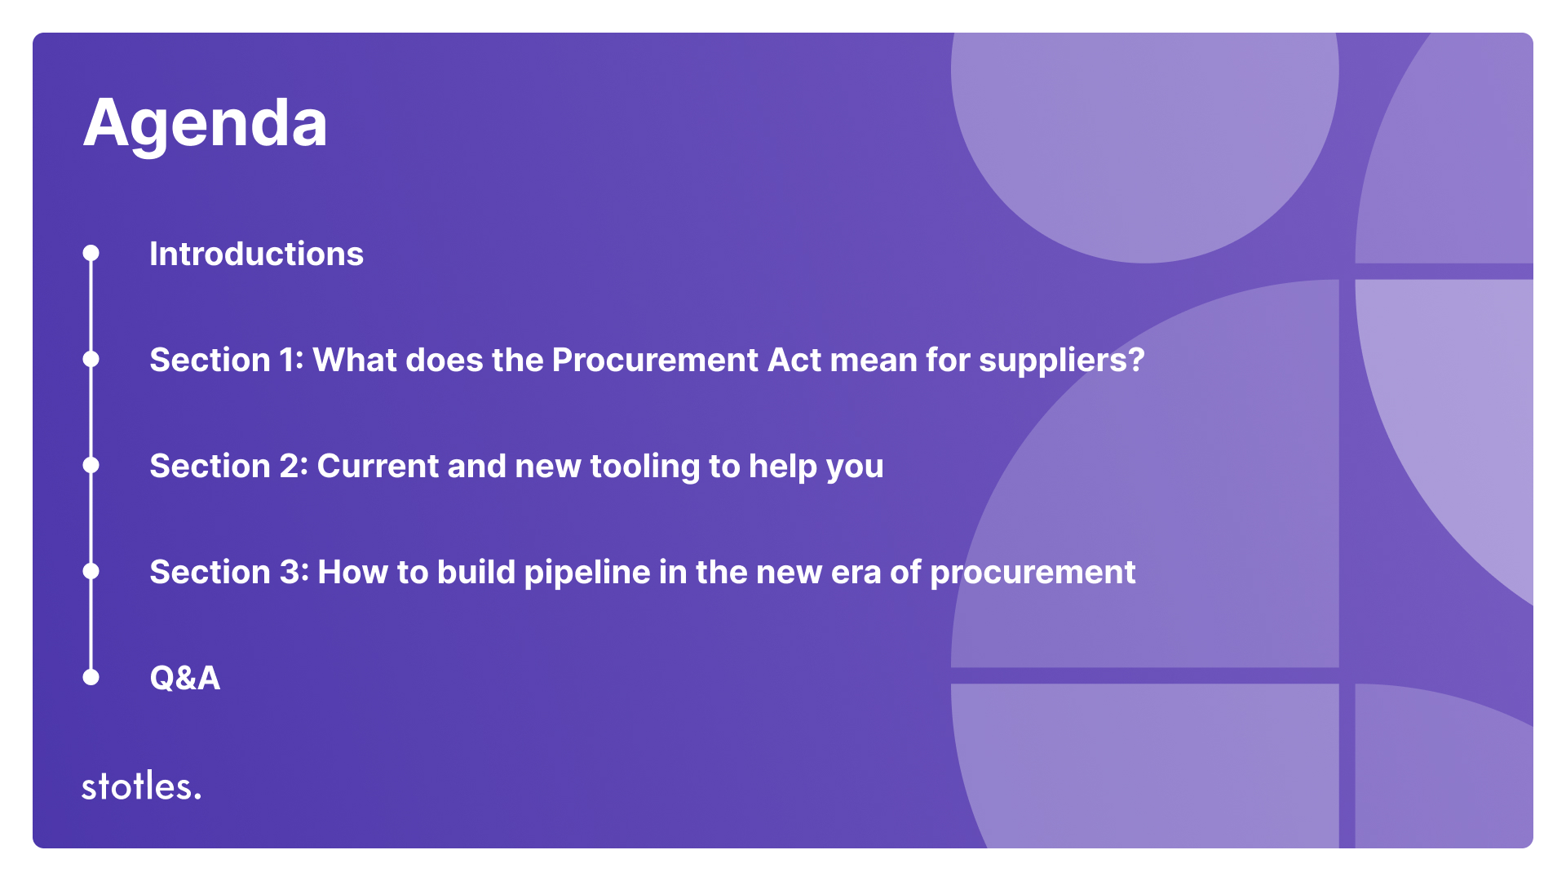
Notes:
The Procurement Act is designed to reform and streamline public sector procurement processes.
Its primary objectives are to:
Simplify procurement procedures
Enhance transparency
Open up public contracts to a more diverse range of suppliers e.g. SMEs
ALIGN PROCUREMENT WITH BROADER GOVERNMENT AIMS: In February 2025, the UK government published a new National Procurement Policy Statement (NPPS) to coincide with the commencement of the Procurement Act 2023
This NPPS outlines strategic priorities for public procurement:
Economic Growth (especially support for SMEs)
Delivering Social Value
Transparency
Value for Money

Slide 5



Do not edit
How to change the design
What is the level of your company's public sector experience?
Presenting with animations, GIFs or speaker notes? Enable our Chrome extension
Notes:
📣 This is Slido interaction slide, please don't delete it.
✅ Click on 'Present with Slido' and the poll will launch automatically when you get to this slide.

Slide 6

Do not edit
How to change the design
What emoji best describes your readiness for the new era of procurement?
Presenting with animations, GIFs or speaker notes? Enable our Chrome extension
Notes:
📣 This is Slido interaction slide, please don't delete it.
✅ Click on 'Present with Slido' and the poll will launch automatically when you get to this slide.

Slide 7
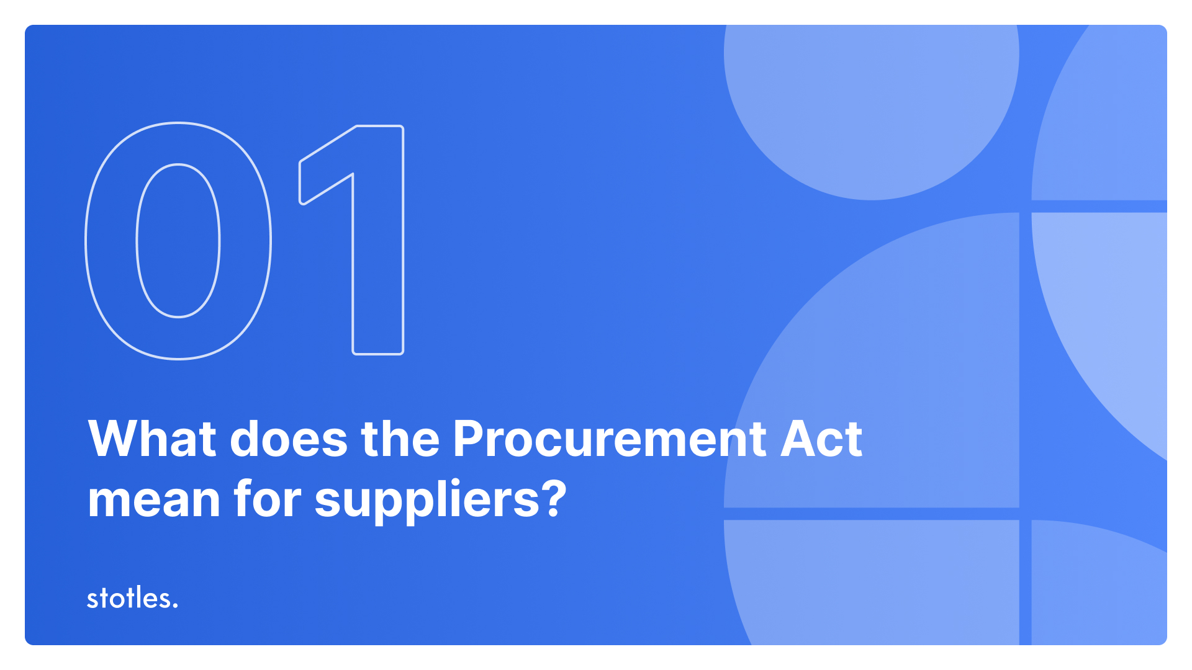

Slide 8
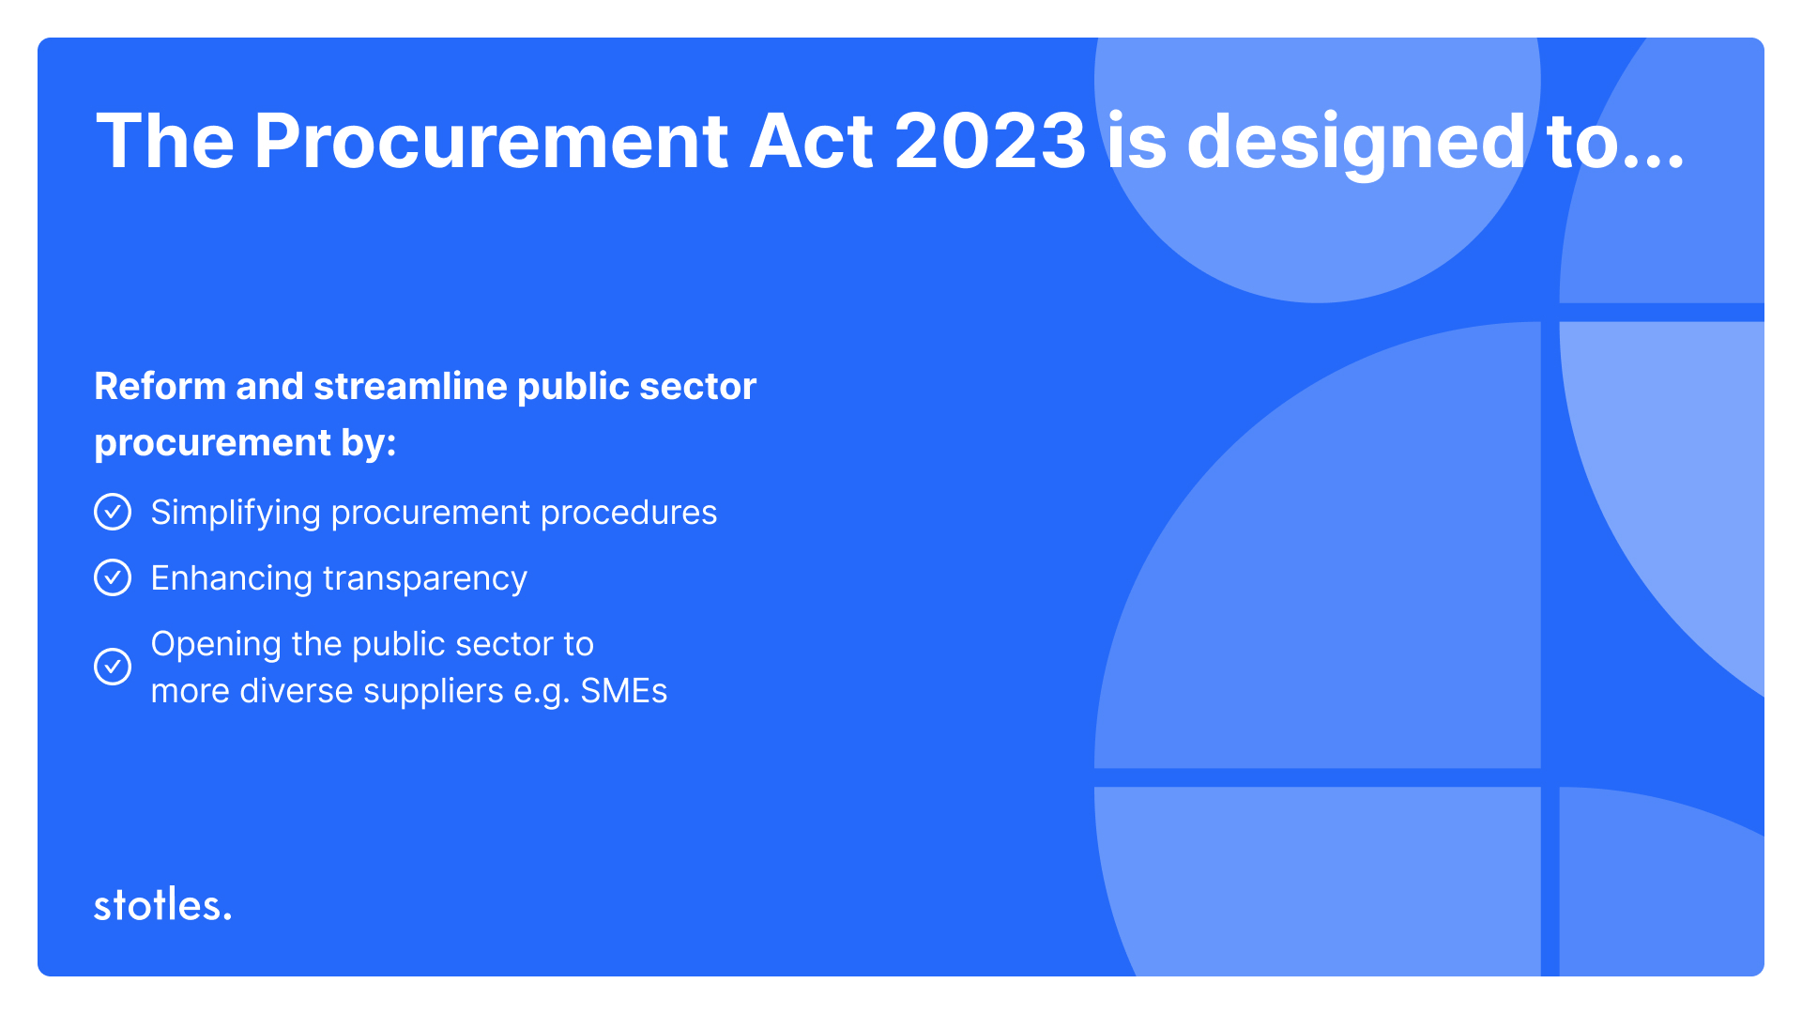
Notes:
The Procurement Act is making selling to the public sector more competitive and commercial
Flexibility is the driver of this, there won’t be cookie cutter procurement and there will be the ability for buyers to procure in a way suitable to their challenges, and the opportunity for you to sell in a way that enables you to build relationships and properly demonstrate how you can meet public sector challenges
The public sector is going to buy in a way that’s a lot more similar to how the private sector buys
This, naturally, will provide opportunities in theory and we’re going to dive into the theories and practicalities today

Slide 9
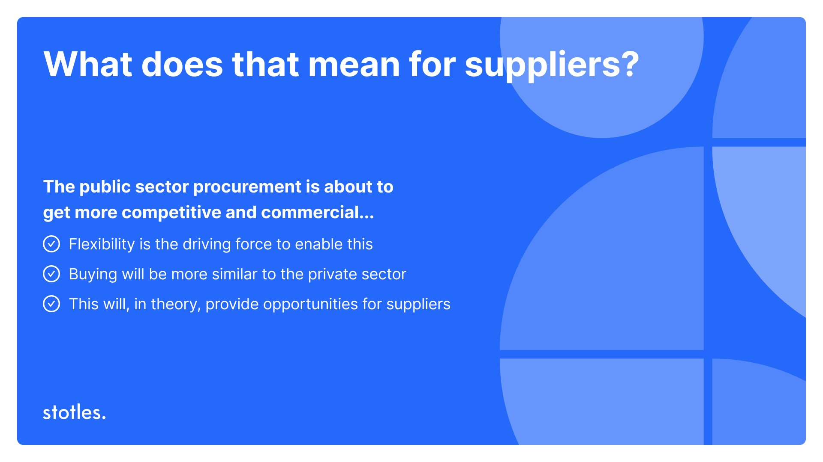
Notes:
More face time with buyers to position yourself as the best option
Competitive Flexible Procedure
This procedure allows authorities to tailor procurement activities to better align with specific project requirements and market conditions.
Contracting authorities can design bespoke, multi-stage procurement procedures which can include negotiations, dialogues, presentations, and demonstrations
Buyers can now engage more with suppliers ahead of and throughout the procurement process which will enable better understanding of the challenge trying to be solved, find opportunities to innovate, ensure value for money
This, overall, is more accommodating to SMEs
More buyer-intent data and signals
Procurement Pipeline Notices
Pipeline Notices are compulsory notices, or documents, that buyers who spend over £100m a year will need to publish to the market outlining their intended spend for the next 18 months.
Pipeline Notices will provide greater visibility into upcoming opportunities for suppliers.
They align with the Procurement Act’s broader transparency agenda, and offer another data-point which will enable buyers to engage early and really get to the root of the buyer problems they’re seeking to solve. This could also lead to increased competition and value for money for the public sector (much like Competitive Flexible Procedure will).
More intelligence on the buying process
The act will introduce several new notice types [HOW MANY?] to enhance transparency and efficiency in public procurement processes.
These notices are designed to inform suppliers and the public about various stages of procurement activities
You’ll have visibility of the types of buying practices of specific buyers, but also when and how particular things were procured which can inform your GTM strategy
These will all be published to the Central Digital Platform which is a consolidated procurement portal where all the data will be stored - it’s an enhanced version of Find a Tender
More routes to market and easier access to RTMs
Open frameworks:
Contracting authorities will be able to periodically reopen frameworks to new suppliers, rather than a single opening and locking out suppliers who didn’t make the cut/missed the deadline for a number of years
The Act stipulates that an open framework must provide for the award of a framework at least once during the first three years from the initial award and subsequently at least once every five years. The entire duration of an open framework cannot exceed eight years from the date of the first award.
If there is no limit on the number of suppliers, existing suppliers can be awarded a new framework based on their previous tenders or by submitting a new tender. This approach maintains a dynamic and competitive supplier base.
The movement from Dynamic Purchasing Systems to Dynamic Markets creates a new RTM for most suppliers
DPSs are limited to commonly used purchases generally available on the market (e.g. tems that do not require significant customisation or unique specifications and are commonly supplied by multiple vendors like stationary and office supplies, facilities management, transport, logistics, construction and infrastructure, catering, medical consumables, standard software subscriptions and hosting).
Dynamic Markets can be used for all types of goods, services, or works, excluding concession contracts including complex or high-value projects
Dynamic Markets maintain an open structure, allowing new suppliers to join at any time
This should enhance procurement flexibility, encourage supplier diversity, and streamline processes for contracting authorities

Slide 10
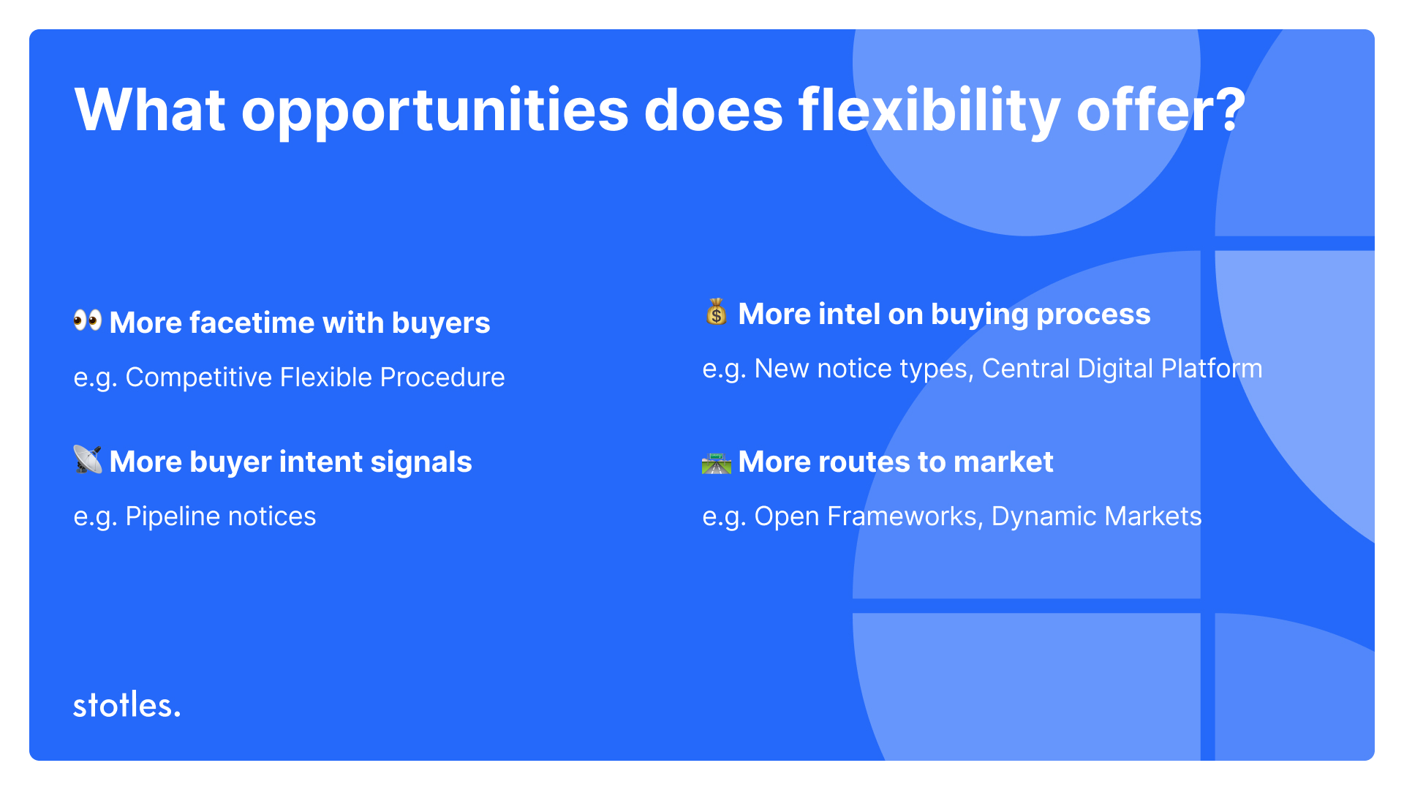
Notes:
More face time with buyers to position yourself as the best option
Competitive Flexible Procedure
This procedure allows authorities to tailor procurement activities to better align with specific project requirements and market conditions.
Contracting authorities can design bespoke, multi-stage procurement procedures which can include negotiations, dialogues, presentations, and demonstrations
Buyers can now engage more with suppliers ahead of and throughout the procurement process which will enable better understanding of the challenge trying to be solved, find opportunities to innovate, ensure value for money
This, overall, is more accommodating to SMEs
More buyer-intent data and signals
Procurement Pipeline Notices
Pipeline Notices are compulsory notices, or documents, that buyers who spend over £100m a year will need to publish to the market outlining their intended spend for the next 18 months.
Pipeline Notices will provide greater visibility into upcoming opportunities for suppliers.
They align with the Procurement Act’s broader transparency agenda, and offer another data-point which will enable buyers to engage early and really get to the root of the buyer problems they’re seeking to solve. This could also lead to increased competition and value for money for the public sector (much like Competitive Flexible Procedure will).
More intelligence on the buying process
The act will introduce several new notice types [HOW MANY?] to enhance transparency and efficiency in public procurement processes.
These notices are designed to inform suppliers and the public about various stages of procurement activities
You’ll have visibility of the types of buying practices of specific buyers, but also when and how particular things were procured which can inform your GTM strategy
These will all be published to the Central Digital Platform which is a consolidated procurement portal where all the data will be stored - it’s an enhanced version of Find a Tender
More routes to market and easier access to RTMs
Open frameworks:
Contracting authorities will be able to periodically reopen frameworks to new suppliers, rather than a single opening and locking out suppliers who didn’t make the cut/missed the deadline for a number of years
The Act stipulates that an open framework must provide for the award of a framework at least once during the first three years from the initial award and subsequently at least once every five years. The entire duration of an open framework cannot exceed eight years from the date of the first award.
If there is no limit on the number of suppliers, existing suppliers can be awarded a new framework based on their previous tenders or by submitting a new tender. This approach maintains a dynamic and competitive supplier base.
The movement from Dynamic Purchasing Systems to Dynamic Markets creates a new RTM for most suppliers
DPSs are limited to commonly used purchases generally available on the market (e.g. tems that do not require significant customisation or unique specifications and are commonly supplied by multiple vendors like stationary and office supplies, facilities management, transport, logistics, construction and infrastructure, catering, medical consumables, standard software subscriptions and hosting).
Dynamic Markets can be used for all types of goods, services, or works, excluding concession contracts including complex or high-value projects
Dynamic Markets maintain an open structure, allowing new suppliers to join at any time
This should enhance procurement flexibility, encourage supplier diversity, and streamline processes for contracting authorities

Slide 11
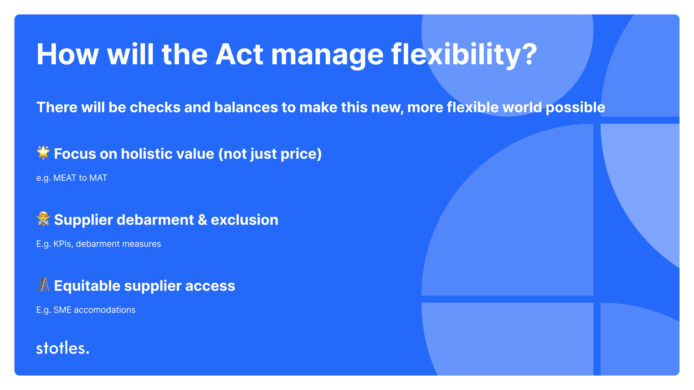
Notes:
There will be checks and balances to make this new, more flexible world possible
The standard suppliers must reach to win and retain contracts is higher, and it will be harder to ‘bad agents’ to continuously work across public sector
The standard suppliers must reach to win and retain contracts is higher and, in theory, it will be harder to ‘bad agents’ to continuously work across public sector
This looks like:
Focus on holistic value and quality (not just price)
MEAT vs MAT
There’s going to be a move from 'Most Economically Advantageous Tender' (MEAT) to 'Most Advantageous Tender' (MAT)
Contracting authorities will now evaluate tenders based on more than just price. Here's some things they'll be considering:
Sustainability
Equality and Inclusivity
Boosting local economies
This shift creates new opportunities for suppliers who can demonstrate added value beyond cost savings e.g. supplier values, long-term benefits, or alignment with public sector priorities, MAT won’t just reward the cheapest solution
Supplier debarment and exclusion lists
Tackling bad behaviour (if you think back to the Horizon Scandal as a very famous example of this) AND general poor performance by suppliers winning public contracts
KPIs
The Procurement Act is going to introduce Key Performance Indicators (KPIs) to organisations who win contract worth over £5 million.
Supplier performance will be tracked, assessed, and publicly reported to increase the accountability of the private sector to deliver on the goals and promises set out when a contract is award
At least three KPIs must be set in contracts valued at £5m (unless deemed inappropriate)
KPI performance will be assessed annually and published publicly in the form of performance notices
Poor KPI performance will lead to exclusion from future contract awards
Suppliers must continuously demonstrate value throughout the lifecycle of a contract
This is intended to increase transparency, accountability, and push the standard of public services up by only engaging suppliers who meet their contractual commitments
Suppliers will be assessed on KPIs like:
On-time delivery
Value for money/effectiveness of service delivery
Service quality
Equitable supplier access
Easier access to opportunities for SMEs
Buyers will be encouraged to break down large contracts into smaller lots, improving SME access and ability to compete on more contracts
Payment terms will be enforced, ensuring suppliers (especially SMEs) get paid faster
Supplier capability assessments will be standardised, reducing unfair barriers for smaller businesses

Slide 12
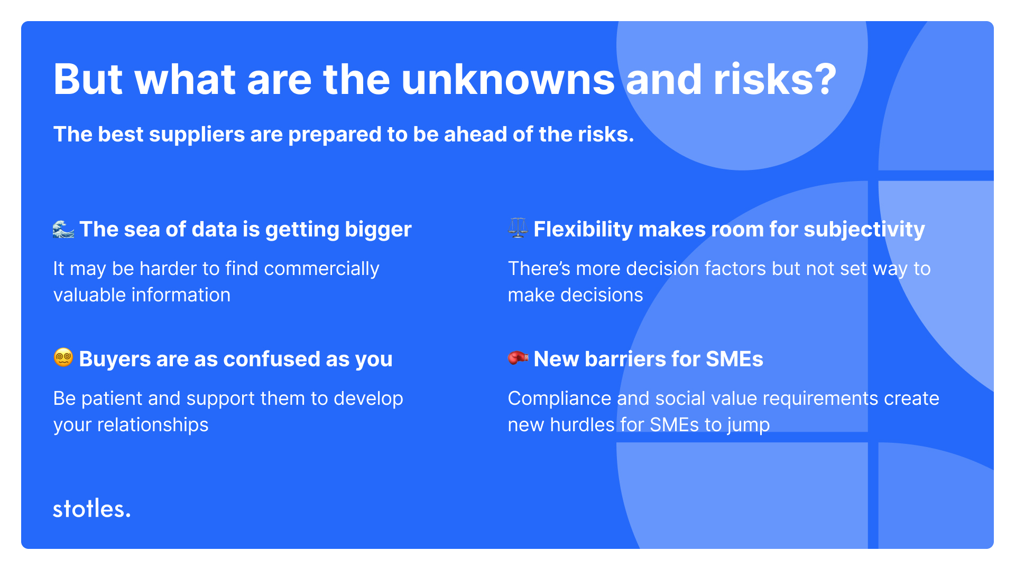
Notes:
These are all really exciting things, and it’s important to see them as opportunities for success
BUT, nobody truly knows how it’s going to work in practice
It’s prudent to be aware of the potential risks and to have foresight of where you need to be ahead
For example:
The sea of data is getting bigger
The Procurement Act is bringing additional notice types and centralising them in the Central Digital Platform
It’s already hard to find opportunities across the platforms like findatender etc, you’re going to have even more information to wade through to find the insights which will help you build strategies and opportunities
The information being published itself is valuable, but in terms of being able to use it to your advantage the sea of data points is getting even bigger and it’s just getting put in one place
‍Buyers are as confused as you
CFP is theoretical as of now, and there’s no set way of doing it by it’s nature
The buyers themselves don’t know how it’s going to work and won’t have experience using this approach, this is a huge change for buyers so be patient with them, work with them while they work it out
This also provides an opportunity for you to strengthen your r/ship with them as they work it out in the first few months under the Act
BUT don’t expect it to be perfect and easier to sell immediately - it’s going to be a collaboration
Flexibility makes room for subjectivity
There’s a risk that flexibility in the procurement process will make room for subjectivity
There’s more decision factors and no set way to make decisions
This may favour incumbent suppliers, as the public sector is notoriously risk averse, or it could lead buyers to lean into any biases beyond value-led decision-making (which is what we also see in private sector buying, people buy emotionally and often come into a buying process with a set idea of what they wan
New barriers for SMEs
I know this counters the point about the procurement act helping SME access, but there’s new factors it introduces which will create barriers to entry
Social value is more challenging for SMEs to deliver on
SMEs have fewer resources to deliver social value outcomes, or create new programmes to do so
This will require additonal work on their behalf to factor this into their offering
Additionally, new compliance requirements could still be too complex for smaller businesses
Larger firms may still dominate due to resources and expertise in navigating procurement processes, particularly with their capacity to adapt to the new world

Slide 13
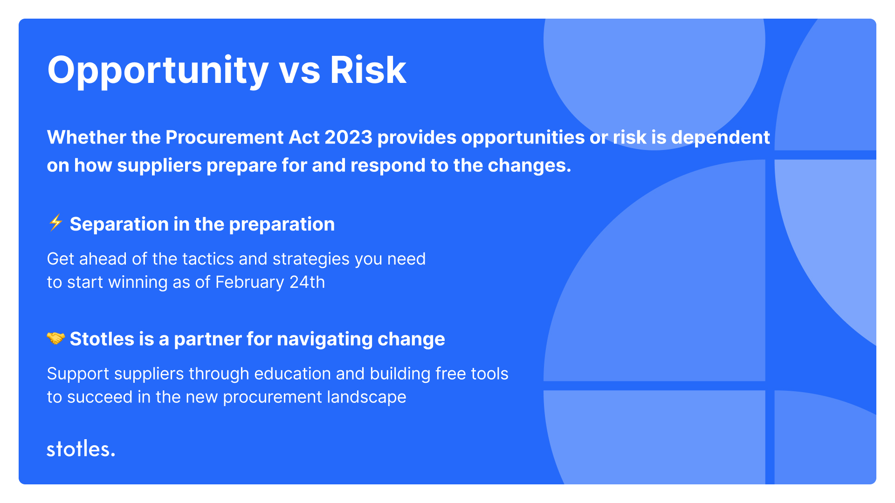
Notes:
Whether the Procurement Act 2023 provides opportunities or risk is dependent on how suppliers prepare for and respond to the changes.
Separation in the preparation
Get ahead of the tactics and strategies you need to start winning as of February 24th
Stotles is a partner for navigating change
Support suppliers through education and building free tools to succeed in the new procurement landscape
We want to be a trusted advisor to you to guide you through the realities of the change in a practical way, not just adding to the deluge of information you’re already receiving across the market
Making sense of the Procurement Act is something we’re dedicated to not just across our market engagement through things like this webinar, but also into how we’re building out platform going forward

Slide 14
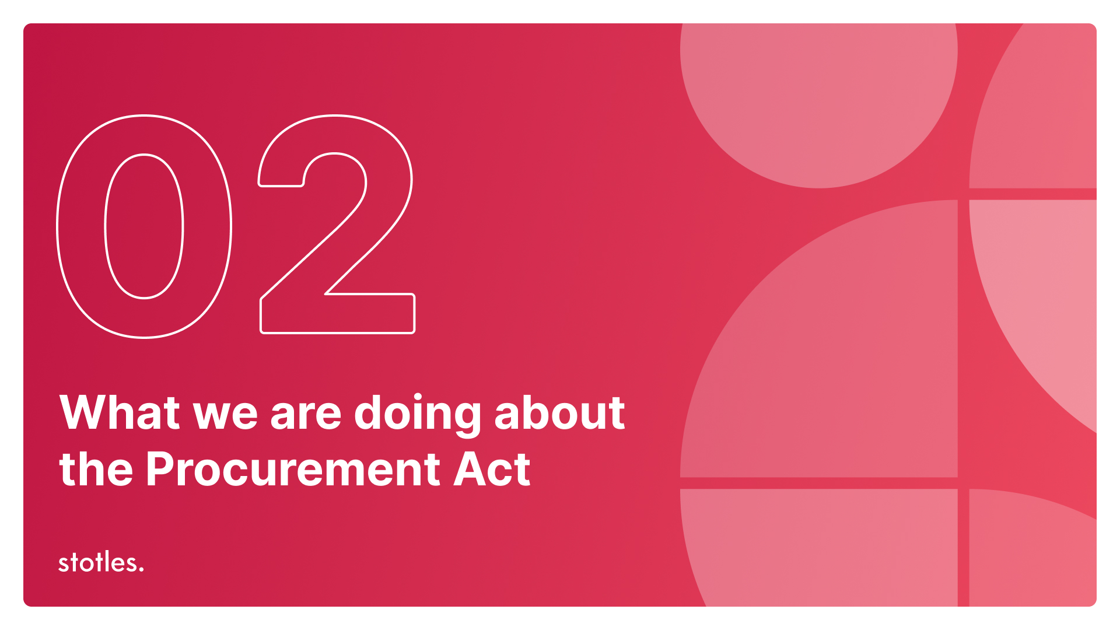

Slide 15
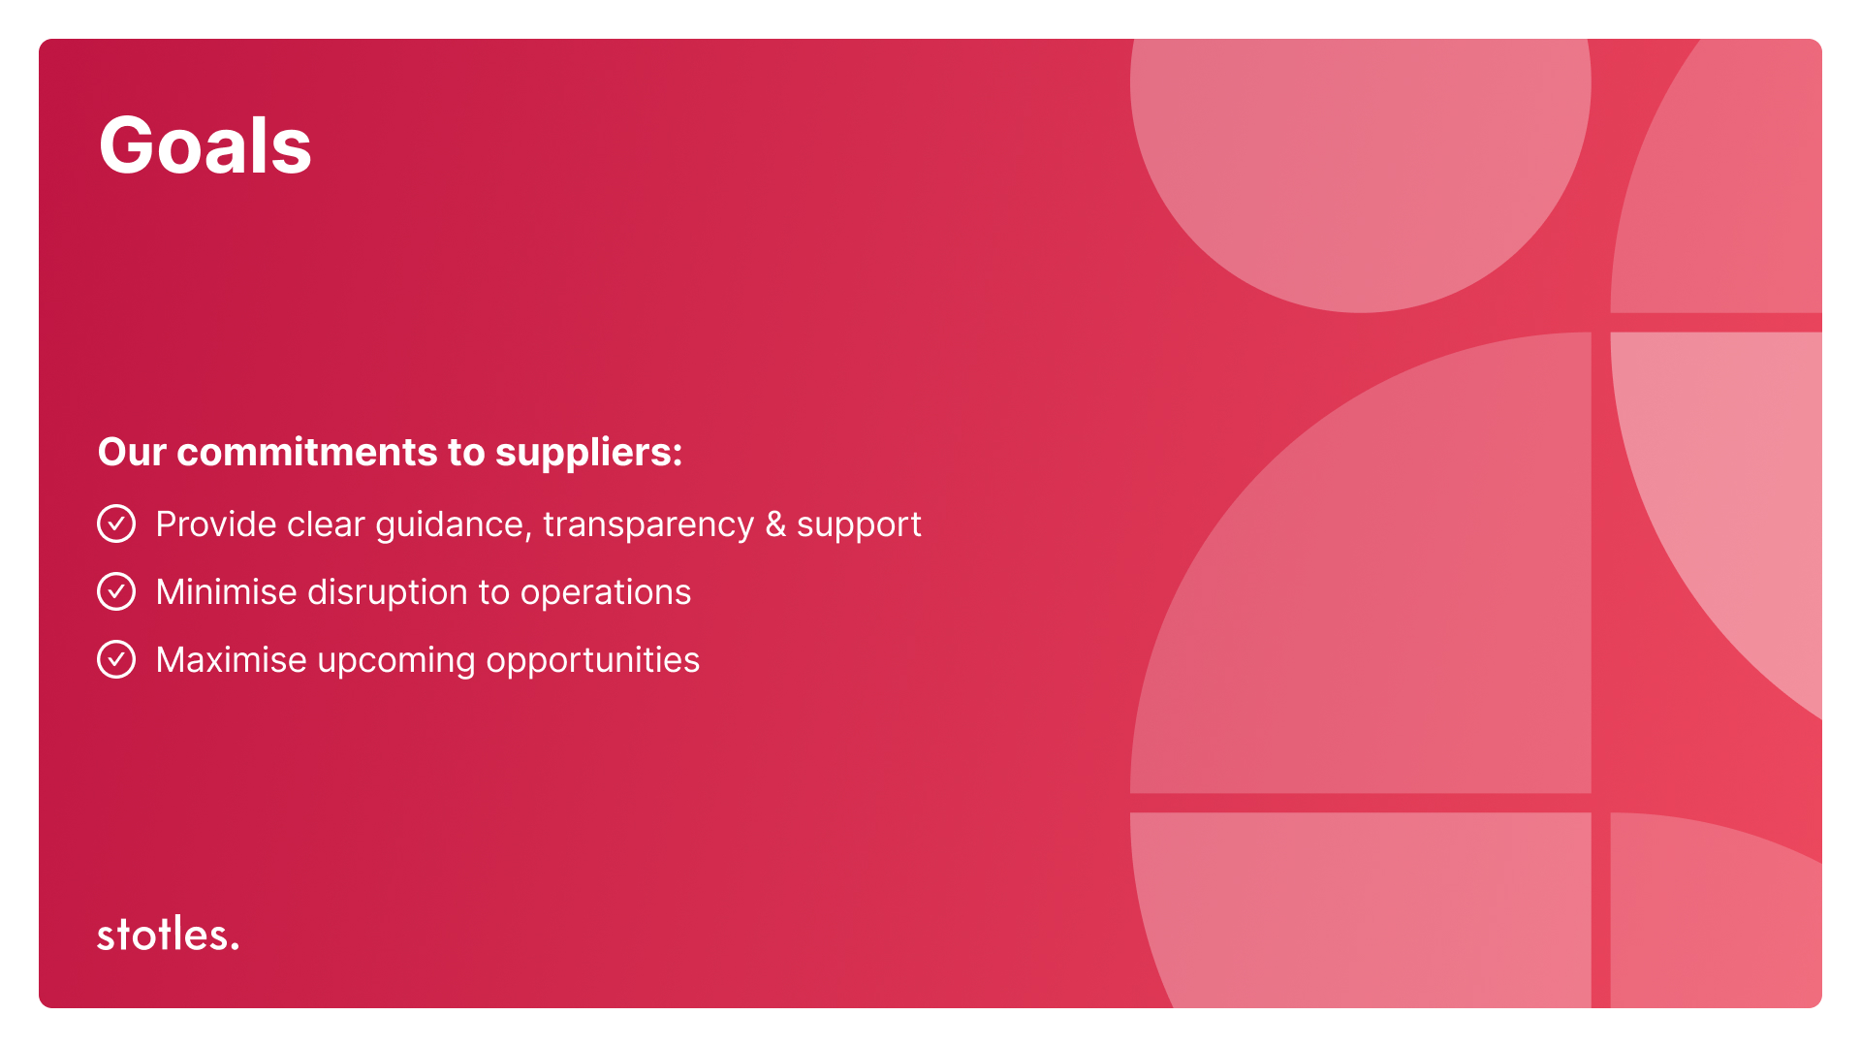

Slide 16
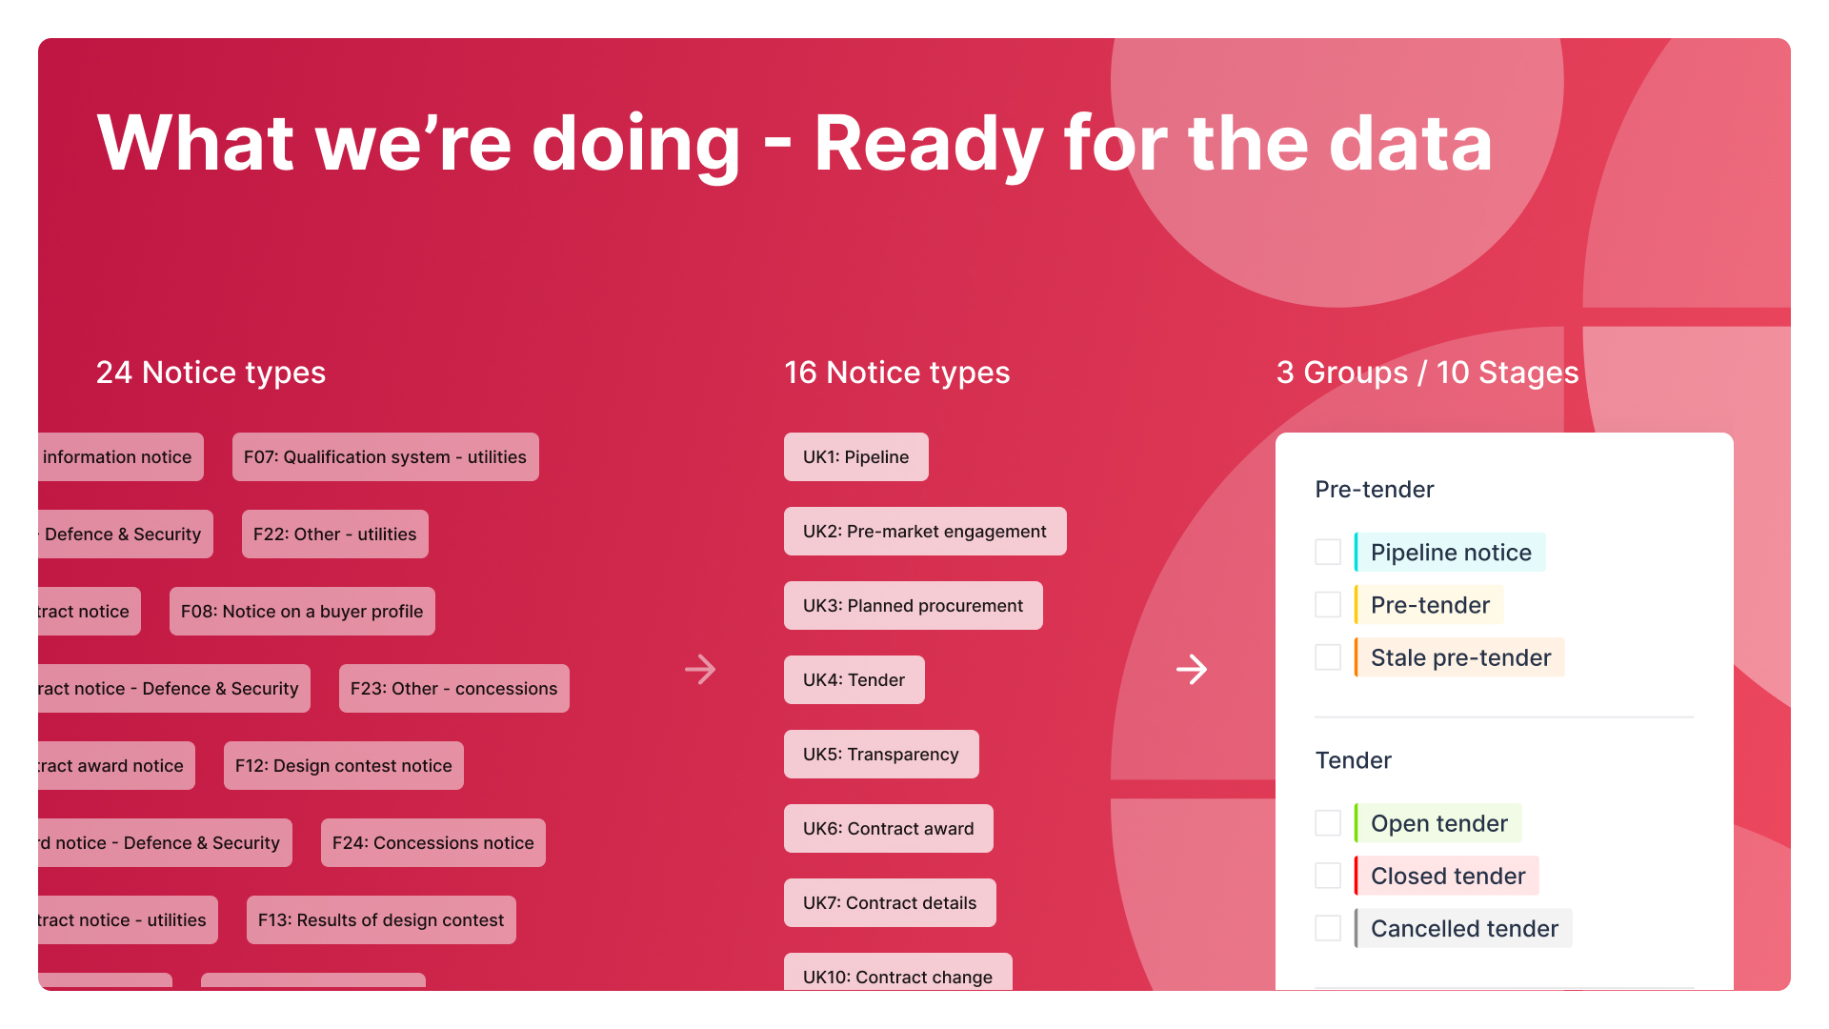

Slide 17
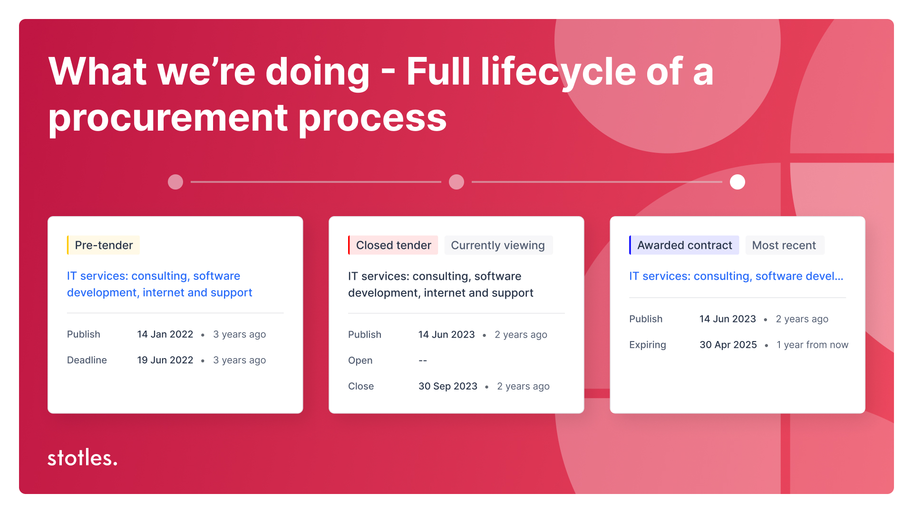

Slide 18
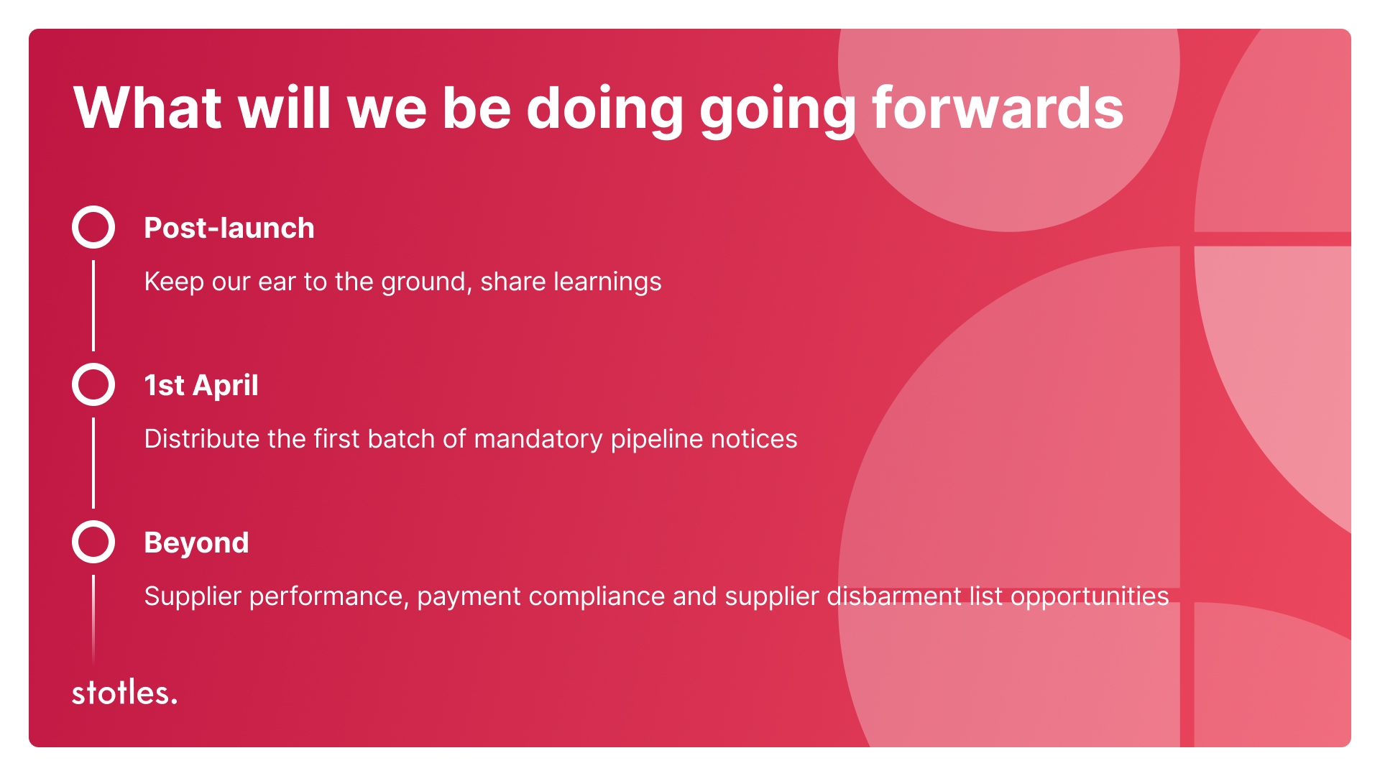

Slide 19
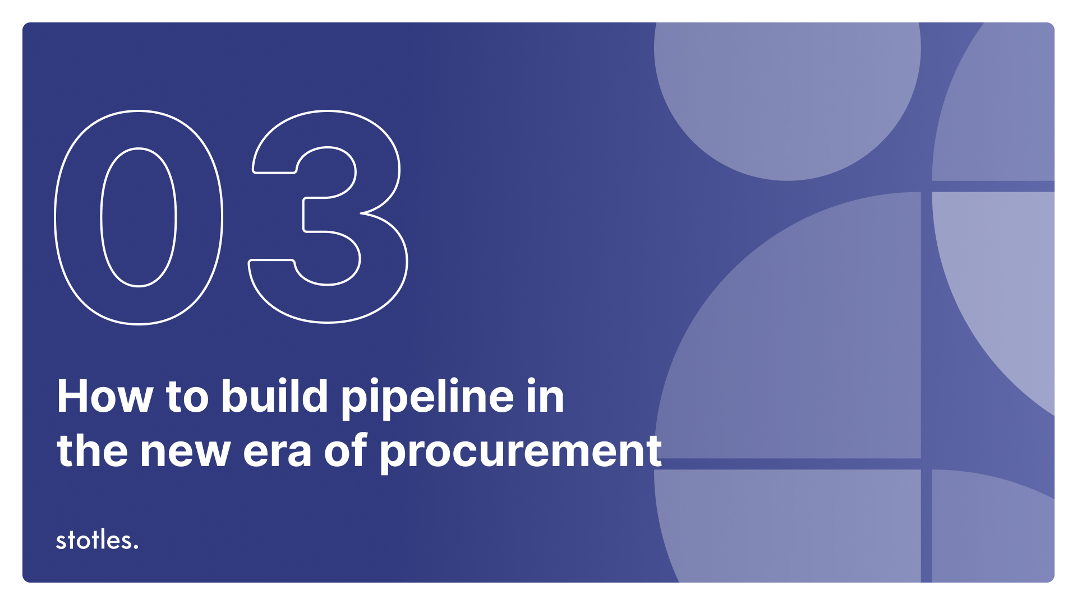

Slide 20
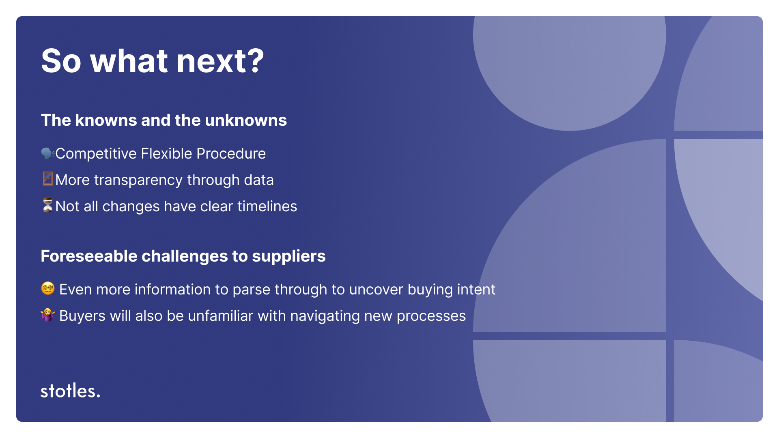

Slide 21
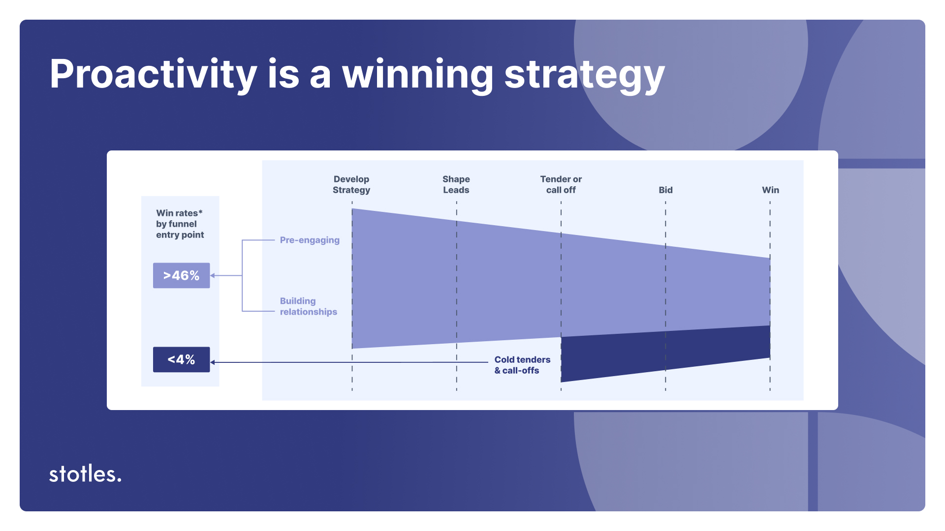

Slide 22
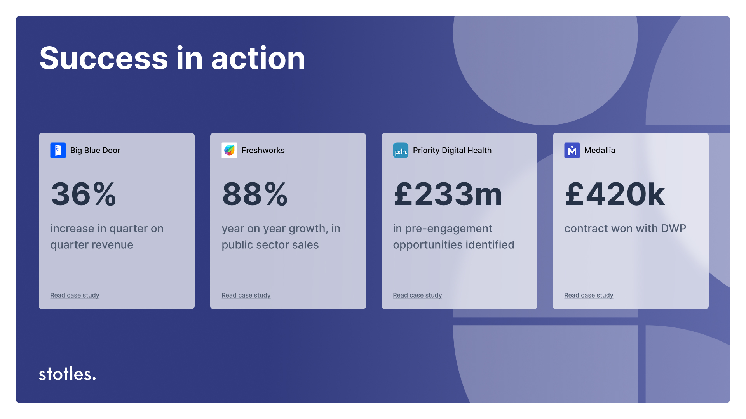

Slide 23
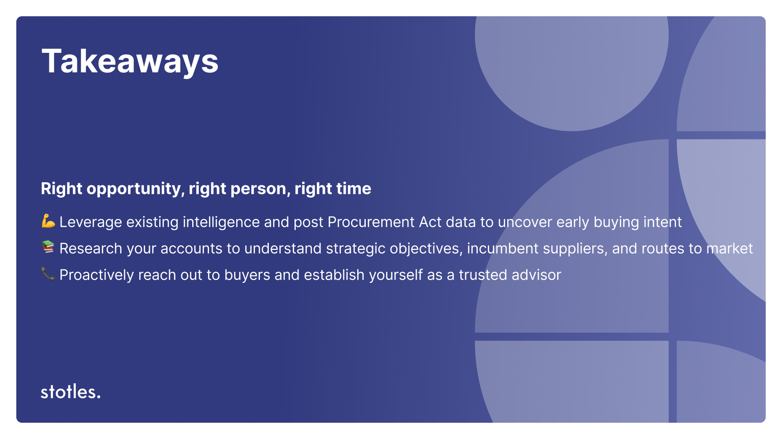

Slide 24

Do not edit
How to change the design
Audience Q&A
Presenting with animations, GIFs or speaker notes? Enable our Chrome extension
Notes:
📣 This is Slido interaction slide, please don't delete it.
✅ Click on 'Present with Slido' and the questions from your audience will appear when you get to this slide.

